Slide 1
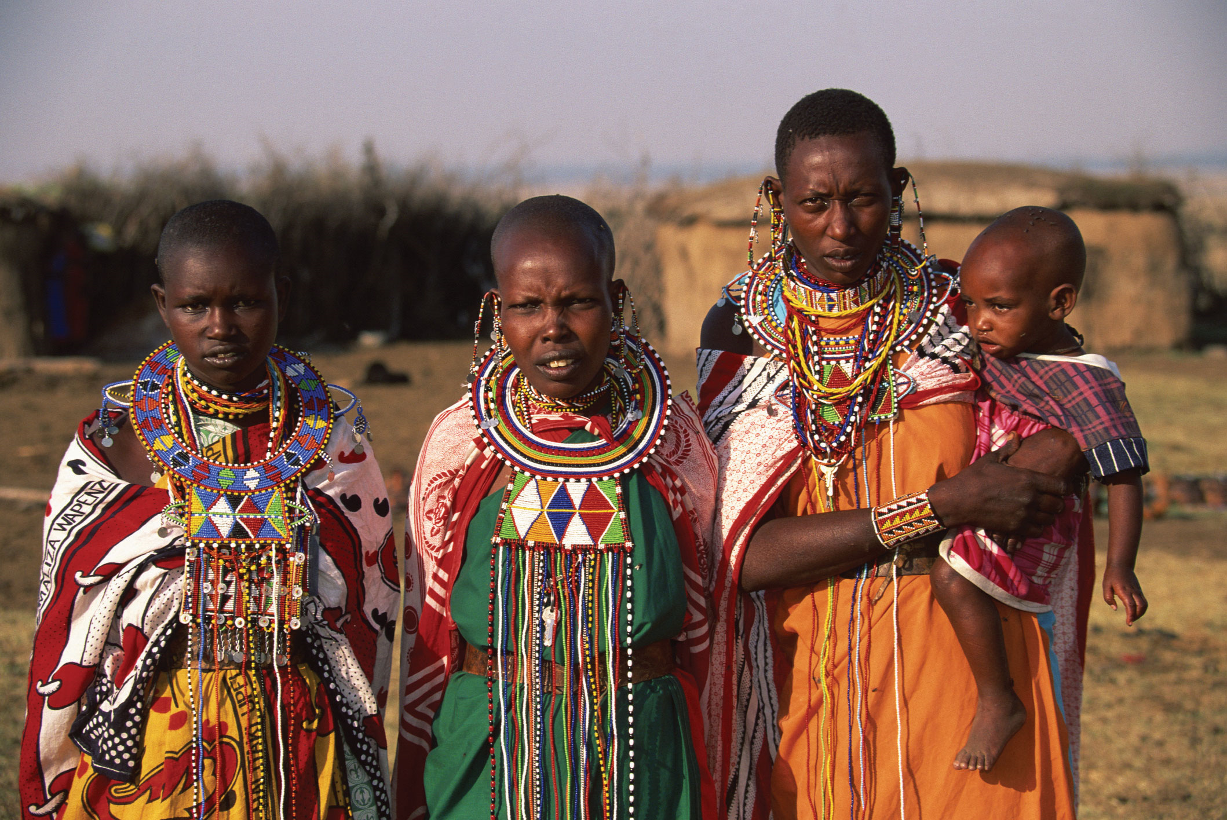
Sub-Saharan Africa
2019
The World Needs Our Support!

Slide 2
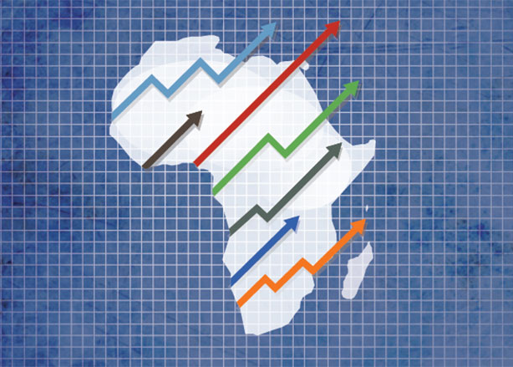
An Overview Of The Analysis
22 Countries
Includes Africa’s largest crude oil exporter
Large gap in economies
Notes:
Shree
The Sub Saharan Africa consists of 22 countries. This region is Africa’s largest crude oil exporter. 40 to 50% of GDP’s of most of the countries depends on oil export. Most of oil from Africa comes from sub saharan region. There is also a large gap in economies of these countries. For eg. Nigeria has a very low GDP per capita whereas Mauritius is ranked in top 20 countries when GDP per capita is concerned.

Slide 3



Methodology Used For The Analysis
Python code
Cleaning the data
Imputing Missing value
Finding outliers
Notes:
Shree
We used python to clean the data and generate insights for visualization. We cleaned the data and removed some columns based on some research. After deciding the path we were going to follow. We deleted the irrelevant columns. We deleted some columns because all the data was missing from those columns and that data was not available on the web as well. We imputed missing values for the columns which were very important for our research. Using boxplots and other visualization methods we determined the outliers for the columns.

Slide 4
Defined ways for Imputing Missing Values
Identifying missing values
Using mean & median to fill in missing values
Utilizing historical data
Notes:
Shree
We used three different methods to impute the missing data. First we identified the columns having missing data. We found data for one column on internet. For another column we found some historical data. After checking for outliers in that data we decided to take the mean of that data to generate the data for 2017. For the third column where only two values were missing, we checked for any outliers in the column.There were no outliers so we calculated the average of the entire column and imputed that in the two missing values.

Slide 5
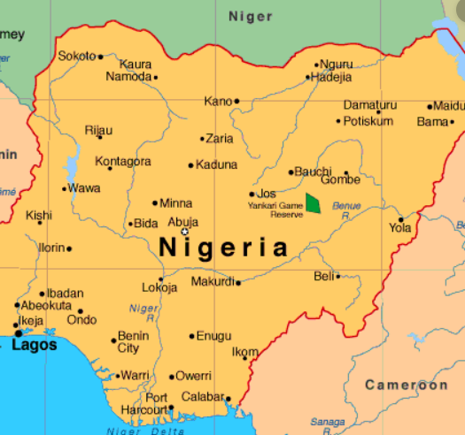
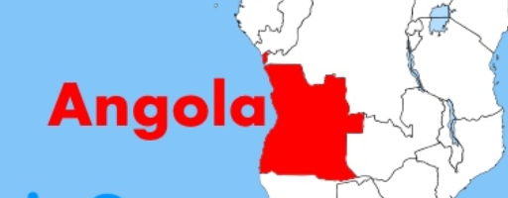
Data Analysis On The Two Important Countries
Angola
Nigeria
Angola
Nigeria
Growth - 0.15%
122B USD
4170 USD per capita
Agriculture
48% of region GDP
Oil exports
0.8% growth
$2000 (approx)
Notes:
Sarthak
Guinea’s GDP growth rate is 13.36% because thermal energy generation, bauxite mining, and strong agricultural sector. Exports are mainly precious stones and minerals
Nigeria accounts for 48% of the entire region’s GDP. The reason for this is because it is the largest economy in Africa, as well as the top oil exporter.

Slide 6
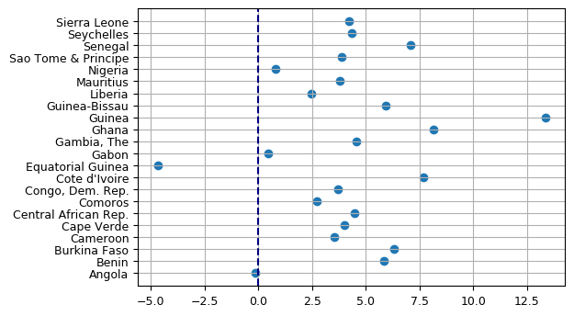
Data Analysis- GDP growth
Guinea:
Mining sector.
Diversification.
Equatorial Guinea:
Oil dependency.
Oil prices decreased.
Weak financial
management (corruption).
No diversification.
Angola:
Low prices.
Low production.
Private sector growth model.
Macroeconomic stability.
Notes:
Marco
Equatorial Guinea.: Oil reserves found in 90s. Also gas. Third largest exporter in Sub Saharan (After Nigeria and Angola)
Drop oil prices. Oil dependency. No reserves. Weak public financial management.. Then, economic diversification (Agriculture and Tourism). Poverty reduction.
Angola’s negative GDP growth is due to lower oil prices, production levels, as the oil sectors accounts for ⅓ gdp and 90% exports. Equatorial Guinea has a declining hydrocarbon sector, lack of economic diversification, high level of infrastructure
Macroeconomic stability has been restored and maintained through a more flexible exchange rate regime, restrictive monetary policy, and fiscal consolidation
Guinea: Foreign investment in mining sector (iron,gold and diamonds). The mining industry grew at an annual rate of roughly 50% in 2016 and 2017, while the non-mining sector posted a 5.6% growth rate, with investment in infrastructure and the expansion of the primary and tertiary sectors remaining strong. Agriculture and natural resources, as well as the manufacturing and services sectors, are some of Guinea’s economic assets.

Slide 7
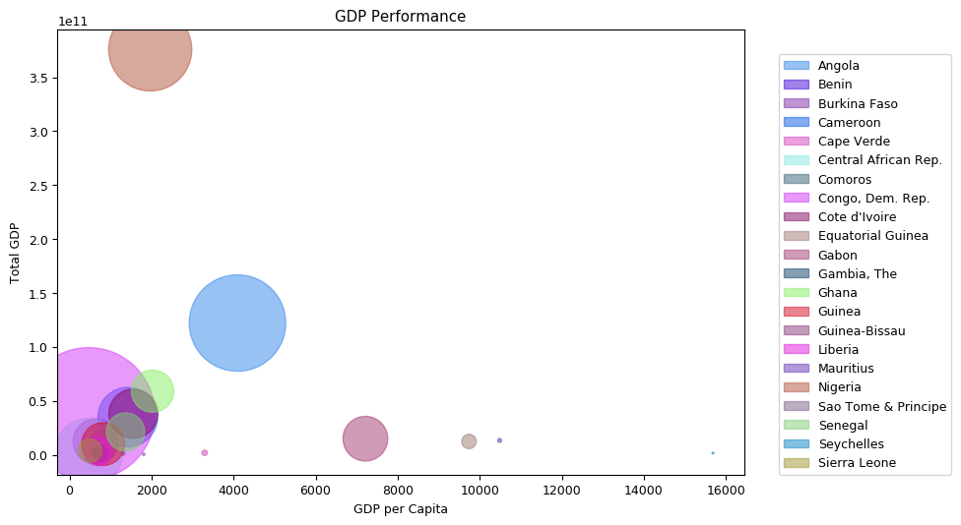
Data Analysis- GDP Performance
Equatorial Guinea:
Corruption
Seychelles:
Tourism
Mauritius:
Construction, Tourism,
and Services.
Nigeria:
Oil dependency.
Weakness of
agriculture sector.
Inflation.
Employment.
Angola:
Low diversification.
Congo:
Import goods and services.
Notes:
Equatorial Guinea: Has revenue from oil exports. 76.8 percent of people lives in poverty. Worse yet, the clear majority of revenue procured never leaves the hands of the political elite.
Seychelles:has the highest gross domestic product (GDP) per capita in Africa ($15,410 in 2016), but inequality is significant, placing the prospect of continued shared prosperity in tighter focus. Climate change also poses long-term sustainability risks.Seychelles tourism industry, but the sector is also benefiting from increases in tourists from other regions, facilitated in part by more airline connections. The formal unemployment rate was 3.5% in the third quarter of 2018, indicating a tight labor market consistent with robust recent economic conditions.heavy reliance on imported goods and on foreign funding for investment.
Mauritius: has an extremely high GDP/square km because it has recently transformed its economy from a low-income agricultural based economy to a diversified upper middle-income economy with growing industrial, financial, and tourist sectors. The economy currently depends on sugar, tourism, textiles, and financial services.
Angola’s negative GDP growth is due to lower oil prices, production levels, as the oil sectors accounts for ⅓ gdp and 90% exports. Equatorial Guinea has a declining hydrocarbon sector, lack of economic diversification, high level of infrastructure
Nigeria: The weakness of the agriculture sector weakens prospects for the rural poor, while high food inflation adversely impacts the livelihoods of the urban poor.Employment creation remains weak and insufficient to absorb the fast-growing labor force, resulting in high rate of unemployment (23% in 2018), with another 20% of the labor force underemployed.
Congo: Despite increased mining exports, the current account deficit widened from 2.9% of GDP in 2017 to 3.9 % of GDP in 2018. This deterioration in the country’s investment position is mainly due to the largest increase in imports of goods and services related to the rise in mining investments and to election expenses in the second half of 2018.
Seychelles 45 , Equatorial Guinea : 55, Mauritius: 60, China: 76, Chile and Brazil.

Slide 8
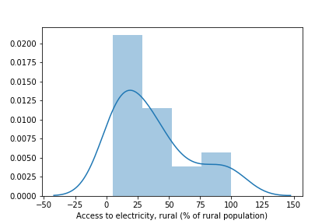
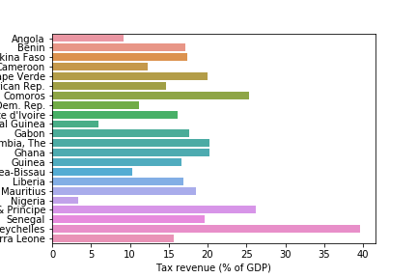
Data Analysis- Additional Findings
Rural Electricity
No normal distribution
Mauritius and Seychelles
Seychelles dependence on trade
Merchandise trade is 123% of GDP
70% exports consists of fish
18% imports consists of tuna
Nigeria’s Tax Rate:
As low as 3.4%
Government efforts
Notes:
KC
There is no normal distribution in terms of access to electricity for people living in rural areas in the Sub-Saharan region. This explains the problem of underdevelopment in the region. The reason for skewed distribution is because of Mauritius and Seychelles, they have 100% electricity coverage in rural areas.
Seychelles heavily relies on imports and exports of trade, as it accounts for 123% of their GDP. Their majority exports consists of processed and unprocessed fish, machinery, and recreational boats. Imports consist of petroleum products, machinery, and manufactured goods. This means that Seychelles relies heavily on fishing, as it takes up 70% of its exports. As for imports, the majority of products consist of unprocessed frozen fish- tuna to be specific. The tuna is used to supply their canning factories. To put this into perspective, they imported around 1.3 billion dollars and exported around 700 million dollars in 2017, which is higher than their total GDP.
The reason for Nigeria’s low tax revenue of 3.4% is simply because people are not paying taxes. The government has issued penalty and prosecution for those who did not declare taxes, but the message has not yet gotten across to the people. Furthermore, the government efforts to force people to pay taxes was successful on only 8% of their target. One of the reasons why Nigerians are reluctant to pay taxes is because they know that the money will be absorbed by the government, rather than being spent on education, health, and public benefit.

Slide 9
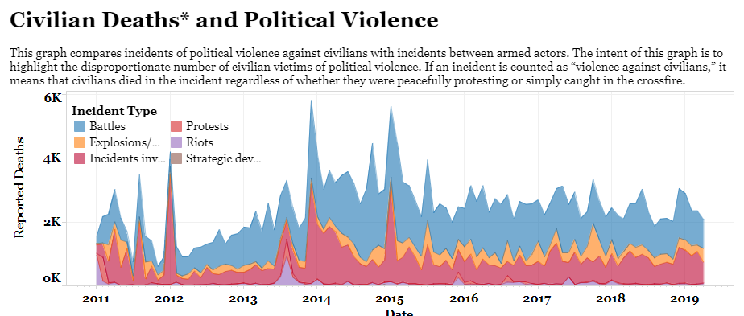
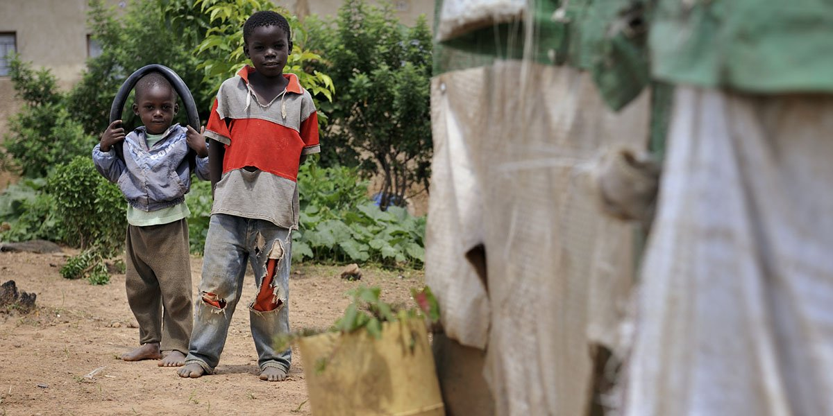
Problems
Instability
Civil wars and crises
Terrorism
Political unrest
Lack of Diversification
Lack of Education
https://www.cfr.org/africa-sub-saharan/sub-saharan-security-tracker/p37884
Notes:
JP
instability: Civil wars and crises
have broken out in multiple African countries since 2010, reversing the previous decade’s trend of stabilization
Terrorism such as the example in Nigeria with Boko Haram at the same time South Sudan face a credible risk of famine in early 2019; in both, insecurity has hindered aid access to affected zones.
Central African Republic (CAR), Mali, Burkina Faso, Cameroon, Burundi, and South Sudan, while long-running conflicts continue to affect the Democratic Republic of Congo (DRC), Sudan, and Somalia.

Slide 10

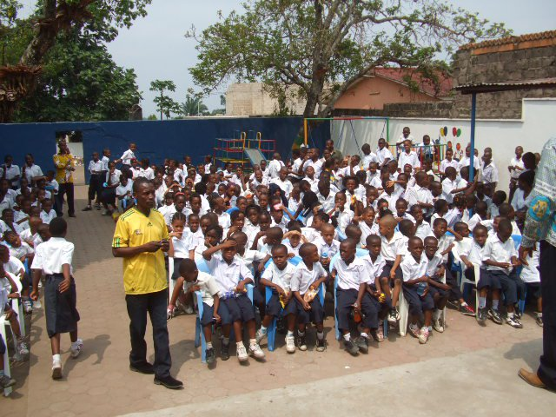
Recommendations
Single-commodity domination
Structural economic transformation needed
Risk mitigation strategy for long term peace prospect
An educated workforce is essential for stimulating long term economic growth and reducing poverty
Notes:
JP
Lack of diversification: single-commodity domination of an economy can end up shackling growth through fluctuations in currencies and commodity prices. Some in the sub saharan region are more vulnerable than others, even though most are still very vulnerable because their economies are dependent on the export of one or just a few commodities or primary products. When there is a downturn in commodity prices, mono- economies such as Nigeria, Angola, and DR congo suffer economic stagnation.
For example, Vietnam has successfully integrated into the global economy through its value chains.Some African countries are faring better in terms of diversification. Mauritius, for example, was once dependent on sugar for revenue. The country has now shifted its focus to tourism and textile exports. The amazing beaches of Mauritius attract tourists from around the world.

Slide 11
Thank You

Slide 12
References
Equatorial Guinea Overview: https://www.worldbank.org/en/country/equatorialguinea/overview
Equatorial Guinea: https://www.borgenmagazine.com/why-is-equatorial-guinea-poor/
Angola Overview: https://www.worldbank.org/en/country/angola/overview
Guinea Overview: https://www.worldbank.org/en/country/guinea/overview
Seychelles Overview: https://www.worldbank.org/en/country/seychelles/overview
Seychelles Trade: https://oec.world/en/profile/country/syc/
Seychelles Trade 2: http://www.fao.org/3/a-br801e.pdf
Mauritius Overview: https://www.worldbank.org/en/country/mauritius/overview
Angola Overview:https://www.worldbank.org/en/country/nigeria/overview
Congo Overview: https://www.worldbank.org/en/country/drc/overview
Nigeria Tax Problems: https://www.bbc.com/news/world-africa-49566927

Slide 13
References
Tax Revenue (Missing Values):
Benin: https://www.cia.gov/library/publications/the-world-factbook/geos/print_bn.html
Central African Republic: https://www.cia.gov/library/publications/the-world-factbook/geos/ct.html
Comoros: https://www.cia.gov/library/publications/the-world-factbook/geos/print_cn.html
Congo Dem. Rep.: https://www.cia.gov/library/publications/the-world-factbook/geos/cg.html
Gabon: https://www.cia.gov/library/publications/the-world-factbook/geos/gb.html
Gambia: https://www.cia.gov/library/publications/the-world-factbook/geos/print_ga.html
Ghana: https://www.cia.gov/library/publications/the-world-factbook/geos/gh.html
Guinea: https://www.cia.gov/library/publications/the-world-factbook/geos/gv.html
Liberia: https://www.cia.gov/library/publications/the-world-factbook/geos/li.html
Nigeria: https://www.cia.gov/library/publications/the-world-factbook/geos/print_ni.html
Sao Tome: https://www.cia.gov/library/publications/the-world-factbook/geos/tp.html

Slide 14
References
Senegal: https://www.cia.gov/library/publications/the-world-factbook/geos/sg.html
Seychelles: https://www.cia.gov/library/publications/the-world-factbook/geos/se.html
Sierra Leone: https://www.cia.gov/library/publications/the-world-factbook/geos/sl.html

Slide 15
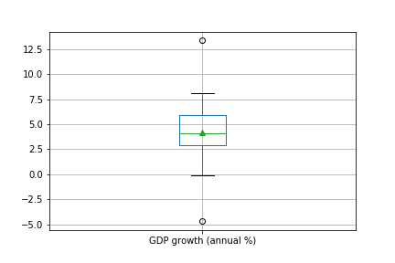
Appendix 1- Region GDP Growth

Slide 16
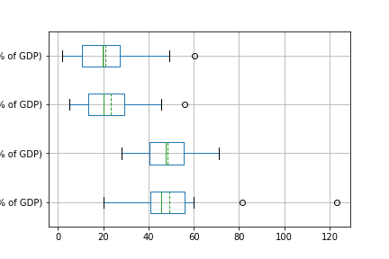
Appendix 2- Industry GDP
Agriculture
Industry
Services
Merchandise Trade

Slide 17
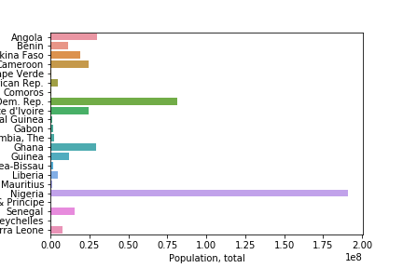
Appendix 3- Population (Millions)

Slide 18
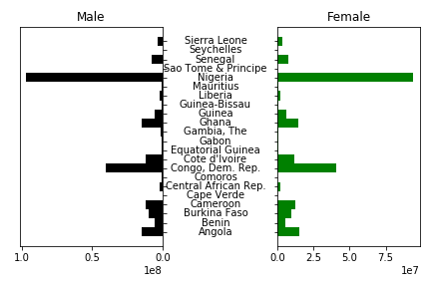
Appendix 4- Population per Gender change

Slide 19
Appendix 5- GDP Performance

Slide 20
Appendix 6- Rural Access to Electricity change

Slide 21
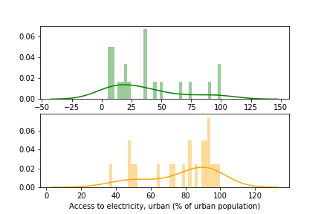
Appendix 7- Rural vs. Urban Electricity

Slide 22
Appendix 8- Tax Revenue Percentage of GDP

